Slide 1
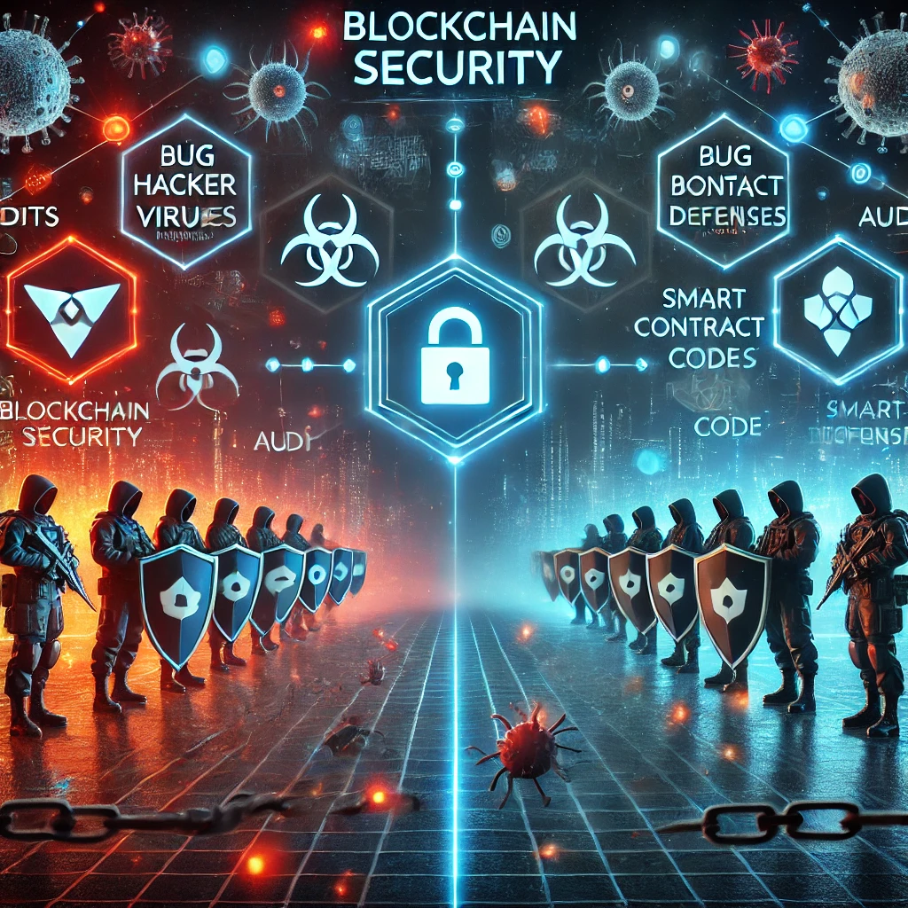
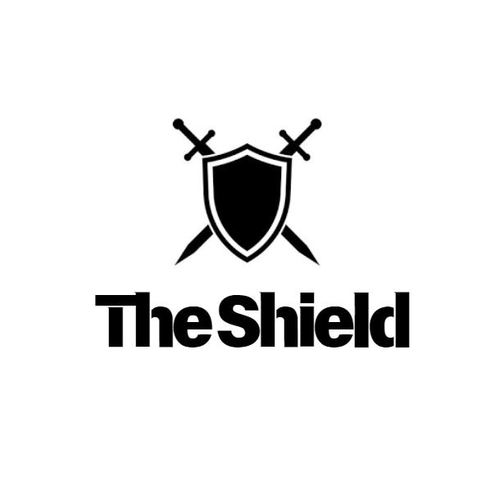
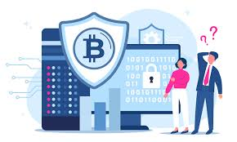
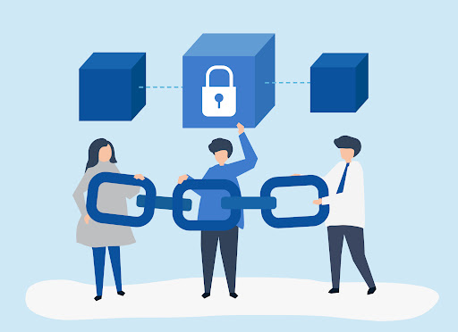
Blockchain Security Battlefield

Slide 2

$ whoami
Alvin Mwambi (@Steiner254)
Blockchain Security Engr `Swypt`
Application Security Engr (Pentests)
Bug Bounty Hunter
Freelancer
Disclaimer: This presentation is based on my personal research and does not represent the views or positions of any of my employers or clients.

Slide 3
Goals
Why web3 security challenges persists
Spoiler Alert: It’s about more than security issues in smart contracts
Look at themes and contributing factors
Get security professionals more involved and curious
Recommendations for making the space more robust

Slide 4
INTRODUCTION
“Blockchain Security Battlefield” delves deep into the world of blockchain and protocol hacks, revealing the most notorious breaches and the lessons learned from them. We’ll explore best practices for smart contract development, ensuring your code is robust and secure. Learn about the importance of smart contract audits and how bug bounties can be a game-changer in identifying vulnerabilities before they become exploits.

Slide 5
Definitions
Web3 is the next phase of the internet focused on decentralization, where users control their own data, digital assets, and interactions directly without relying on central authorities.
Blockchain is like a shared digital notebook that records information in a way that everyone can see and verify, but no one can change.
A Smart Contract is a self-executing program on a blockchain that automatically enforces rules and agreements, so transactions happen without needing a middleman.

Slide 6
Definitions
A Smart Contract Audit is a thorough review of the code in a smart contract to ensure it's secure, functions as intended, and doesn't have any vulnerabilities or errors that could be exploited.
A Bug Bounty is a reward program where organizations offer incentives to individuals who find and report security vulnerabilities or bugs in their software, systems, or smart contracts.
A Protocol is a set of rules for secure communication and transactions between decentralized apps and networks.

Slide 7
Notable Blockchain Hacks
https://rekt.news/

Slide 8

Gone In 60 Seconds?
Gone in 60 Seconds isn’t just a movie — it’s also what happens to your crypto when hackers get a little too close!

Slide 9
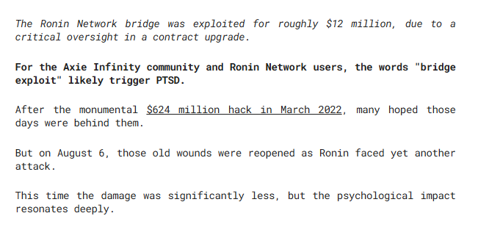
Notable Blockchain Hacks (q1 – q3 2024 stats)
Q1 – Q3 2024, has witnessed approximately $2.1 billion in crypto.
Ronin Network hacked again? – losses $12m just 2 years after the largest crypto hack of all time (they lost $624m)

Slide 10
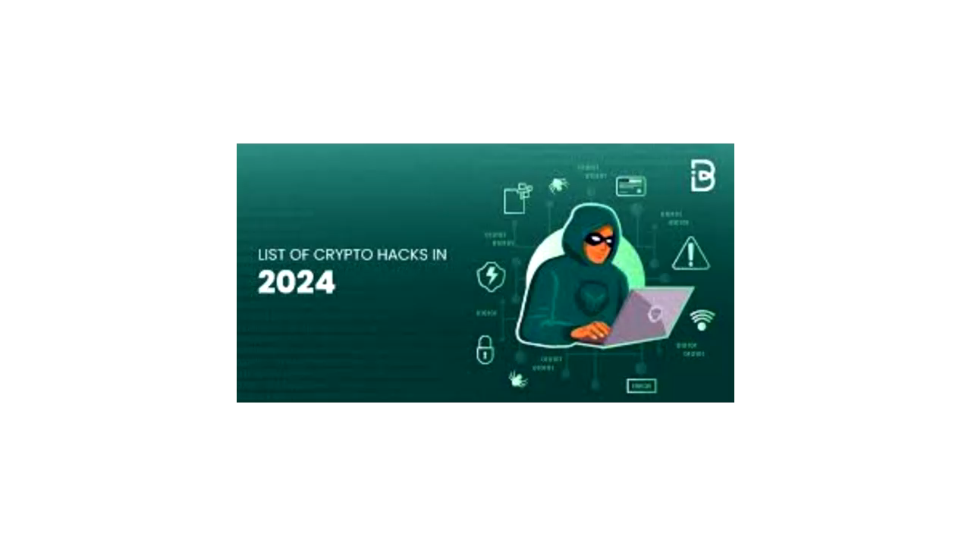
Notable Blockchain Hacks (2024)

Slide 11
Let’s Have A Look At The Following Hacks ;p
Ronin Network (2022 march Hack)
Ronin Network (2024 August Hack)
nicehash

Slide 12
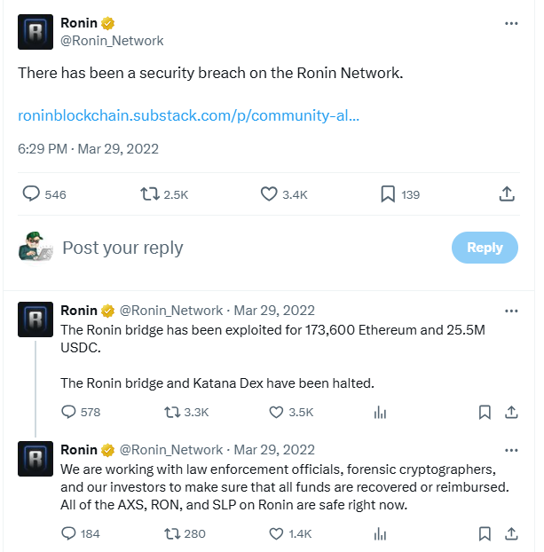
Ronin Network (2022 march Hack)

Slide 13
Ronin Network (2022 march Hack)
$624m was stollen.
Lazarus Group gained access to 5 of the 9 private keys held by transaction validators for Ronin Network’s cross-chain bridge.

Slide 14
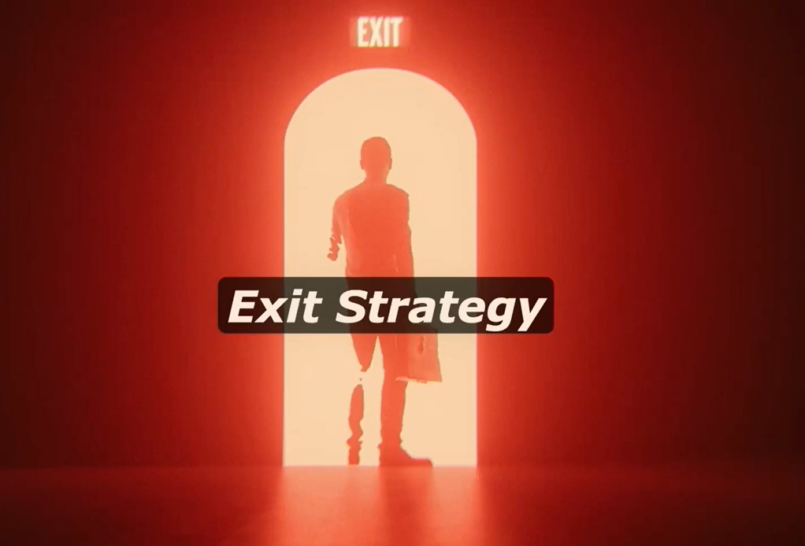
Ronin Network (2022 march Hack) Exit Strategy

Slide 15
Ronin Network (2024 August Hack)
The Ronin Network bridge was exploited for roughly $12 million, due to a critical oversight in a contract upgrade.

Slide 16
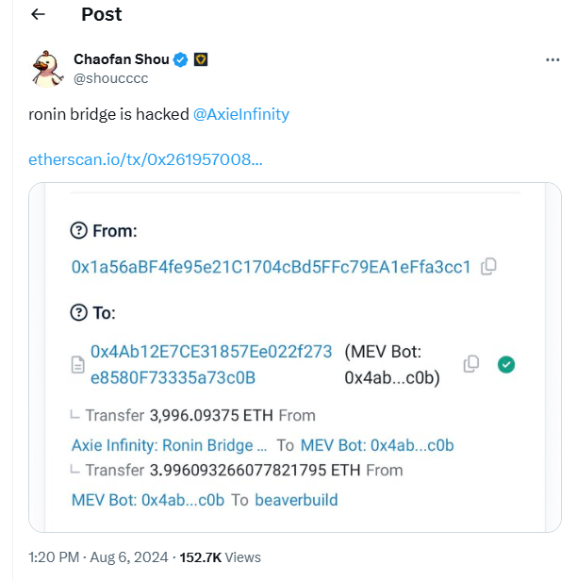
Ronin Network (2024 August Hack)

Slide 17
NICEHASH
A crypto mining market.
Hacked in December 6th 2017.
$64 million stolen.
The Lazarus Group used spear phishing attacks to steal $64 million from nicehash.
Over several years, nicehash managed to repay/refund all stolen bitcoins to it’s users.

Slide 18
Best practices for smart contract development
a). Use Established Frameworks and Libraries
Utilize reputable libraries like OpenZeppelin for common functionalities (e.g., ERC20, ERC721 standards) to avoid reinventing the wheel.
Use secure, well-reviewed frameworks such as Hardhat, or Foundry for testing and deployment.
b). Minimize Complexity (logic)
Avoid complex business logic and keep separate concerns in separate contracts to improve readability and maintainability.
80% of vulnerabilities detected in smart contracts are business logic issues.

Slide 19
Best practices for smart contract development
c). Limit Gas Usage and Optimize Efficiency
Optimize your code to minimize gas costs (e.g., avoid extensive loops).
d). Implement Access Control Mechanisms
Use onlyOwner, roles, or similar access control modifiers to restrict sensitive functions to authorized addresses.
e). Use Safe Arithmetic Operations
Use SafeMath libraries or Solidity’s built-in checked arithmetic (since Solidity 0.8) to prevent overflows and underflows

Slide 20
Best practices for smart contract development
f). Write Comprehensive Tests
Write unit, integration, and security tests for all scenarios, including edge cases, with tools like - Foundry’s fuzz testing.
Ensure your tests cover unusual or unexpected inputs and error conditions.
g). Conduct Security Audits
Have independent security audits done by reputable firms or third-party security professionals before deploying your contracts.
For additional safety, consider bug bounty programs on platforms like Immunefi, HackerOne, Shentu Chain (https://openbounty.shentu.org/)

Slide 21
Best practices for smart contract development
h). Practice Secure Coding for Smart Contracts
Avoid using tx.origin for authorization as it can be spoofed. testing.
Prefer msg.sender for accessing caller information and for authorization checks.
g). Perform Regular Updates and Monitor the Contract
Where possible, use upgradeable smart contract patterns (like proxies) to allow future updates while remaining mindful of their security implications.
h). Document Code and Use Clear Naming Conventions
Use comments to explain complex logic, and choose clear, descriptive variable and function names to improve readability and ease auditing.

Slide 22

Quiz?

Slide 23
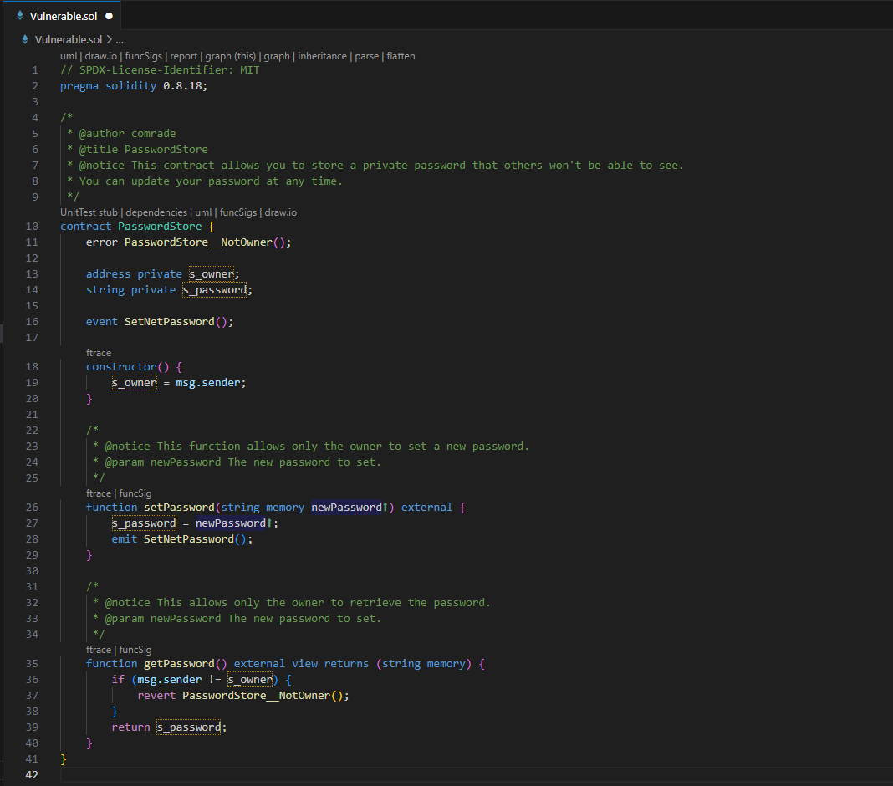
Audit & Catch The Security Issues Here? https://github.com/Steiner-254/BSides-Nairobi-2024/

Slide 24
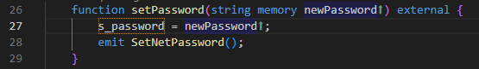
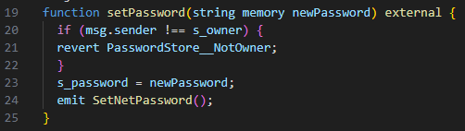
a). Lack Of Access Control (High)
Fix:

Slide 25

b). Lack Of Access Control
Description: The application stored passwords on-chain. This is a major security concern as **all data on-chain is public information**. The business logic of this protocol is flawed!

Slide 26
Smart contract auditing
Smart Contract Auditing is a code review to identify vulnerabilities, errors, and inefficiencies, ensuring secure and reliable blockchain deployment.

Slide 27
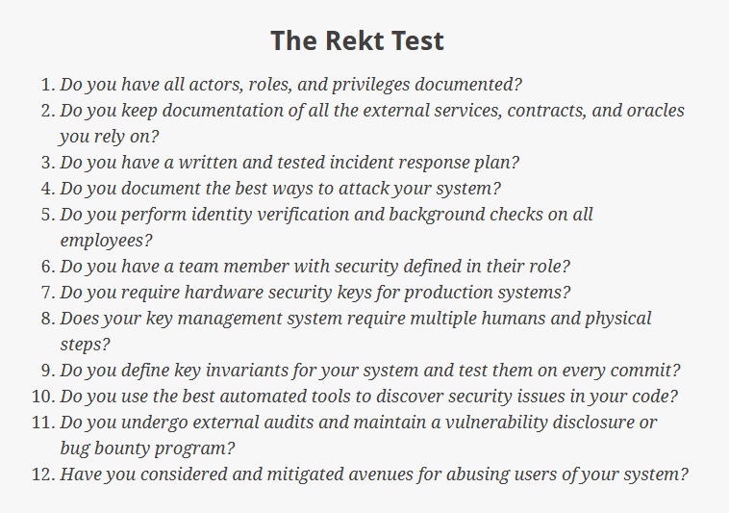
Checklist For Determining Web3 Project Readiness For Auditing

Slide 28
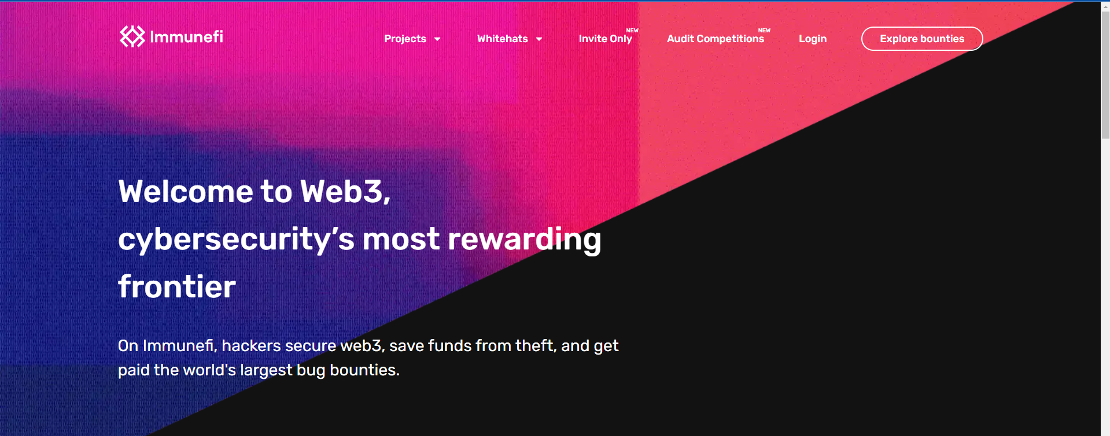
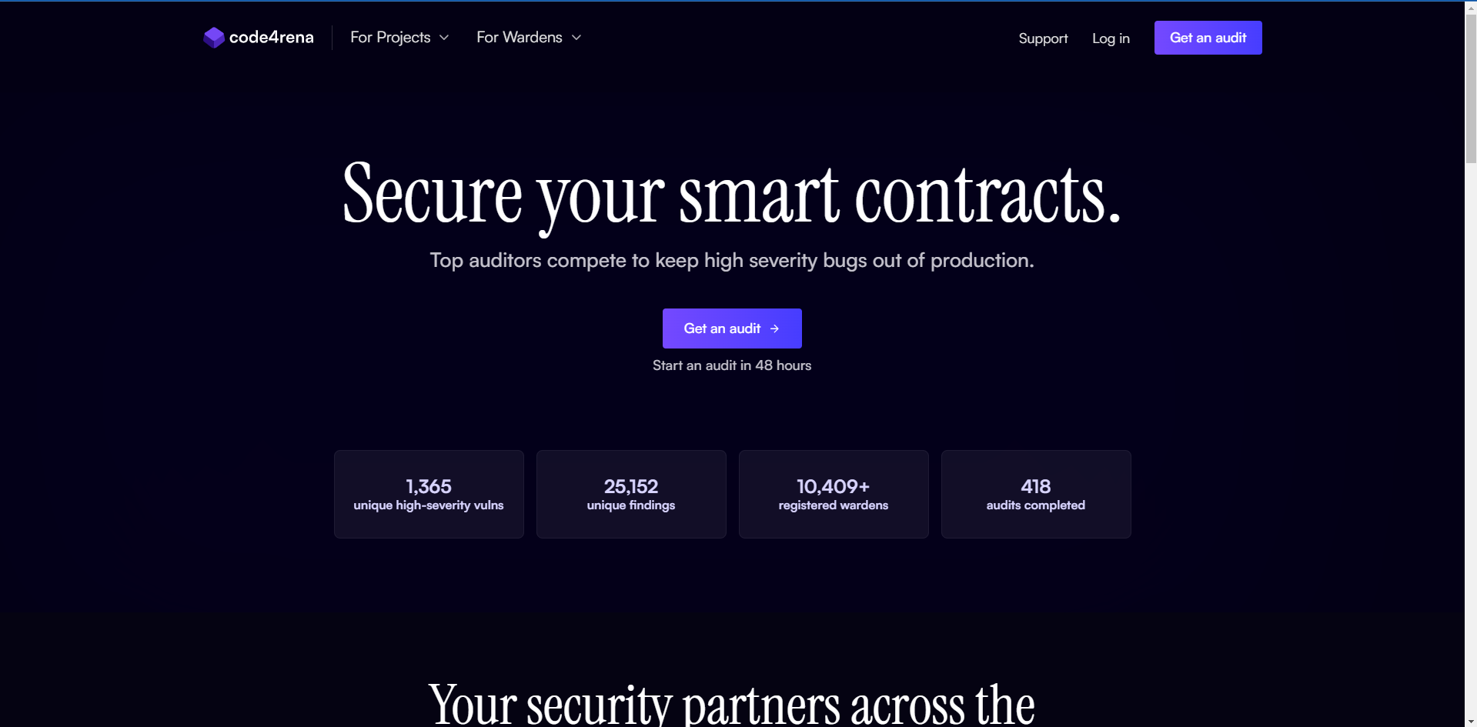
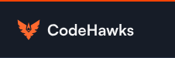
Web3 bug bounty PROGRAMS/CONTESTS

Slide 29
Cultural Issues Inhibiting Security
Making the code NOT upgradable (not able to fix security issues).
Not implementing risk mitigating controls
Pausing Contract
Limiting Funds
Limiting Time
Cloning & Deploying Smart Contracts from public resources such as github.
N/B: All of these makes your project less secure!

Slide 30


Slide 31
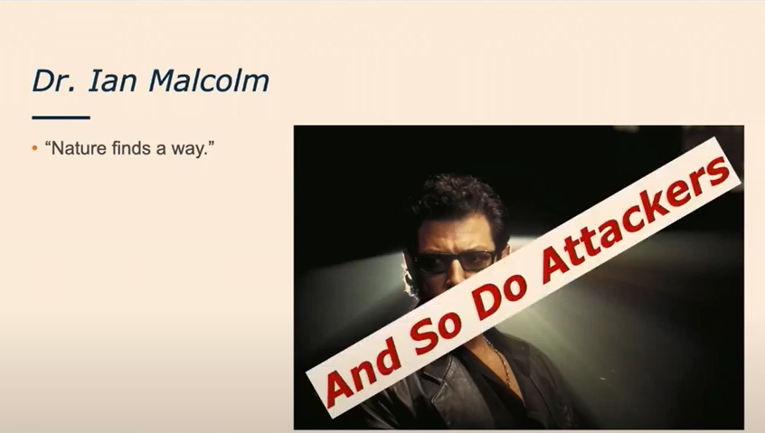

Slide 32
So we need to make sure that projects take necessary precautions & best practices to be secure, otherwise;

Slide 33
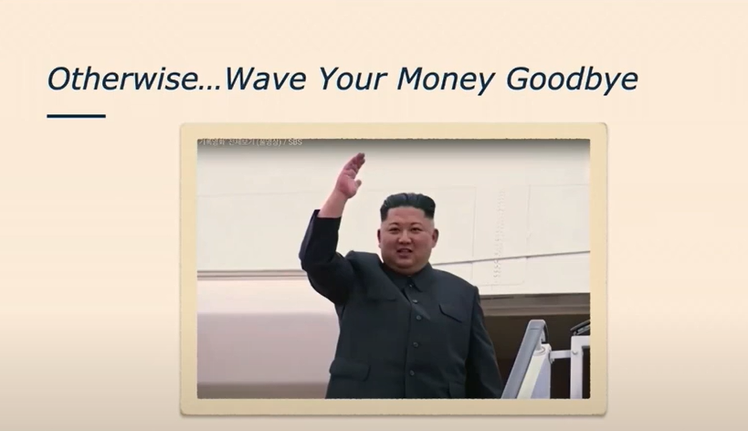

Slide 34
Monitoring and operations
Most projects don’t monitor their deployed project
Not taking advantage of the pubic nature of the chain
Not knowing when you are being attacked
Intelligence
Evolving Space
New attacks are being discovered
Similar projects being compromised

Slide 35

Security Lesson For Blockchain Projects

Slide 36
Security Lesson For Blockchain Projects
By all means have security in place for the projects in all SDLC phases
Use frameworks
Static analysis (run tools that are available)
Create your own custom checks for the known issues
Practice defensive coding (writing smart contracts and dApps with extra precautions to protect them from common vulnerabilities)

Slide 37
Learning Resources
https://updraft.cyfrin.io/ (FREE & Recommended)
https://learnweb3.io/ (FREE)
https://www.youtube.com/@PatrickAlphaC
https://www.youtube.com/@JohnnyTime

Slide 38
references
https://rekt.news/

Slide 39
For The Presentation Slides:

Slide 40

Q&A Questions

